Slide 1
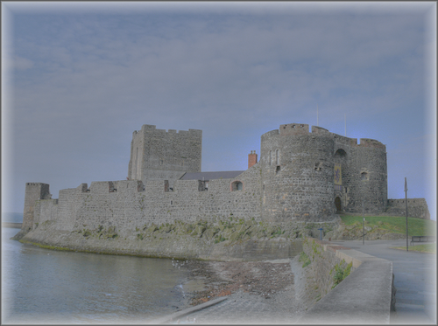



CLC Induction
Notes:
1

Slide 2

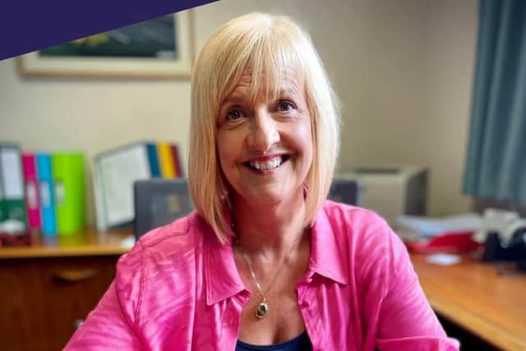
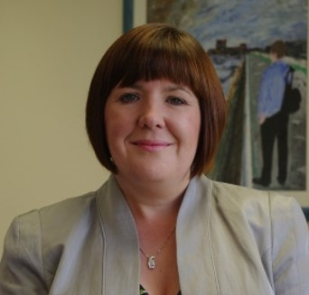
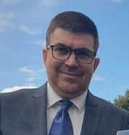

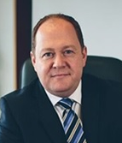
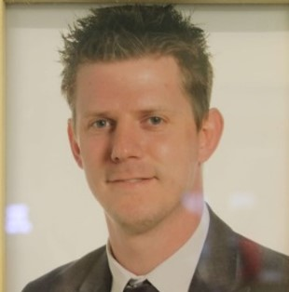
Personnel
Mrs Irvine
Mrs McClean
Mr Maxwell
Mr Martin
Mr Houston
Mr Dunlop
Notes:
2

Slide 3

Aims
Make students and parents aware of the daily running of CLC.
Assure students and parents that our CLC students’ well-being and academic progress is central to this process.
Notes:
3

Slide 4
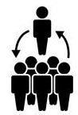
Induction Process 1
Pupil Induction (earlier today!)
Visited host school
Opportunity to meet:
  Fellow travelling CLC classmates
  Subject teachers
  Coordinators
  Child Protection Officers
  Principals

Slide 5

Induction Process 2
Induction Presentation
Provide details for parents/guardians and students regarding the processes involved in CLC.
Notes:
5

Slide 6

Induction Process 3
First lesson induction
Monday 1st September:CGS and CA
Tuesday 2nd September:Ulidia IC
First CLC subject class
Ice breaker activity
Kick start the process of getting to know classmates and teacher(s)

Slide 7

People involved in CLC
Students
Parents/carers
Subject Teachers
CLC Coordinators
Child Protection/Safeguarding Officers
Principals
Mr Beattie (external CLC Coordinator)

Slide 8

Students
Adhere to terms of their student contract.
Good attendance – greater than 95% is expected.
Comply with deadlines and ALWAYS give your best effort.
Ask for help no matter what the issue.
Arrive for taxis and to all classes in good time.
.

Slide 9

Parents or Carers
Your role is vital.
Please encourage your son/daughter to work hard at their academic studies.
‘Attend’ Parent Consultations in your child's host school.
If issues arise it is essential you communicate with CLC coordinators / Year Teams in your daughter/son’s own school.

Slide 10

Subject Teachers
Teaching to agreed examination boards /specifications.
Homework, coursework and portfolio completion.
Monitor, track and set targets for student progress.
Provide feedback to student and parents via parent consultations and reports (Spring Term).
Liaise with CLC Coordinator.

Slide 11

CLC Coordinators
Oversee process
Resolve problems
Communicate with other CLC Coordinators
Communicate with parents

Slide 12

Child Protection Officers
Deal with any issues related to Child Protection/Safeguarding.
Students have had the opportunity to meet with the designated Teacher in Charge of Child Protection/Safeguarding in their host school.

Slide 13



Transport
CLC classes have three timetable sessions:
9.00-11.00, 11.30-12.30 and 1.20-3.25 (ish)
Students make their own way to and from their host school at the start and end of the day
During the school day pupils will taxi/walk between schools.
No taxis between CGS and C Ac.
Taxi shuttle by Mahoods Taxis
All drivers are Access NI approved

Slide 14


Transport arrangements in practice
Session 1: 9am-11am:
Make your own way to your host school
Sign in and be IN class for 9am
Class ends at 11am
Sign out of the host school
Make your way to the taxi pick up point for 11.05am or walk back to your home school
Get into the correct taxi with your peers

Slide 15



Transport arrangements in practice
Session 2: 11.30am-12.30pm
Taxi leaves home school at 11.20am sharp
Sign in at host school and be in class for 11.30am
Lesson ends at 12.30pm
Sign out of the host school
Make way to taxi pick up point or walk back
Taxi leaves at 12.35pm to return you to
your home school

Slide 16

Transport arrangements in practice
Session 3: 1.20pm-3.25pm(ish)
Taxi leaves home school at 1.15pm sharp
Sign in at host school and be in class for 1.20pm
Lessons end at the closing time of your host school
Make your own way home

Slide 17

School Holidays…
Exceptional Closures…
Staff Development Days… etc
If your home school is ‘closed’,
BUT YOUR HOST SCHOOL IS OPEN,
you MUST still attend CLC lessons
(and in school uniform)
Combined schools’ holiday list will be provided by your CLC coordinator and will be available on your school website.
CLC

Slide 18


Key documents
Please read, sign and return:
  Student contract
  Student information sheet
  Permission to drive to CLC form (when appropriate)
Please read and keep safe:
  CLC induction booklet
  CLC combined holiday list

Slide 19



Other queries
Uniform – always worn to your host school, with the exception of educational trips/visits (where relevant) or non-uniform days in your home school.
When in your host school, you follow the rules/expectations of that school.
Educational visits – please let your home/host school know.
Driving to host school.

Slide 20

Questions?
Notes:
20

